Slide 1
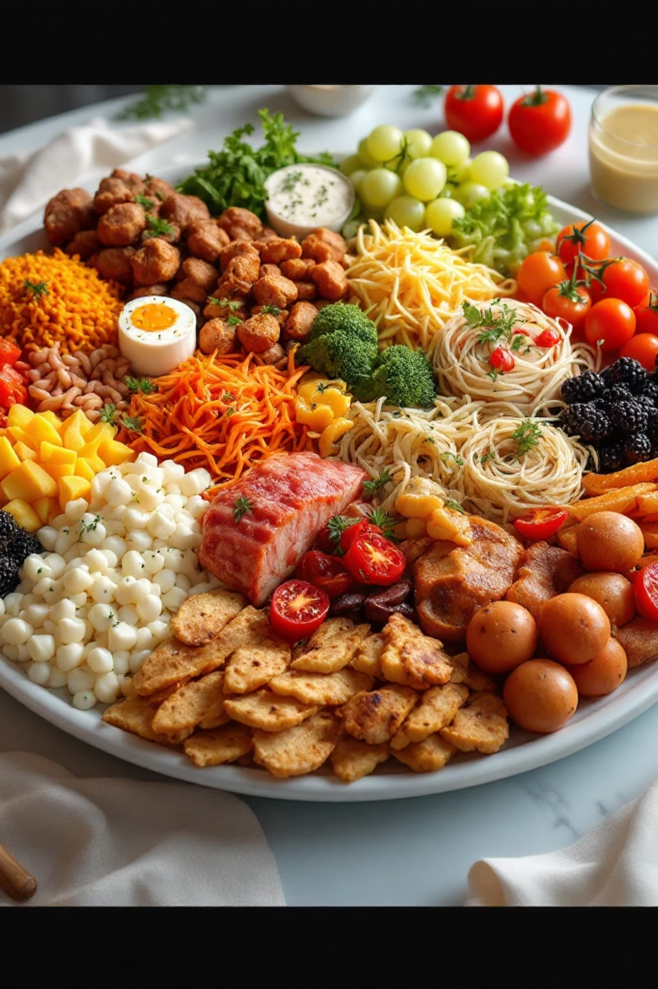
SafeBite: Product Intelligence for Food Safety
A real-time safety platform protecting users with food allergies and dietary restrictions through intelligent product analysis

Slide 2

The Core Idea
Real-Time Protection Layer
SafeBite bridges the gap between complex ingredient lists and your biological needs, translating chemical data into simple, actionable safety signals.
Whether you're managing peanut allergies, following a vegan lifestyle, or avoiding gluten, the platform provides instant Red/Yellow/Green light indicators for informed decisions.

Slide 3
Technology Stack: Hybrid Architecture
A balanced approach combining local development agility with scalable cloud infrastructure
Backend
Database & Auth
Node.js using native http module for maximum control without bulky framework overhead
Firebase Admin SDK for global profiles and community features, with file-based JSON storage for local authentication
Security
dotenv for secret management and scrypt for secure password hashing with crypto protection

Slide 4

Design Philosophy
01
Glassmorphism Aesthetic
Backdrop-filter blur effects with semi-transparent backgrounds create a futuristic, clean visual language
02
Persistent Navigation
Sidebar provides consistent access to features while maintaining focus on content
03
Two-Column Dashboard
Main action area on left with contextual status information on right for optimal workflow
04
Traffic Light System
Immediate cognitive recognition through intuitive colour-coded safety indicators

Slide 5

Natural Language Processing Engine
Sophisticated text processing techniques ensure accurate allergen detection and matching:
1
2
3
Normalization
Stemming & Lemmatization
Tokenization
Text sanitization removes accents (NFD), converts to lowercase, and strips special characters
Split ingredients by delimiters to avoid partial match errors
Custom singularize/pluralize methods ensure "Peanut" matches "Peanuts"
4
Alias Mapping
Recursive library recognizes "Butter" and "Whey" as dairy triggers

Slide 6




API Integrations: Global Food Intelligence
Open Food Facts
Primary source for international barcodes and ingredient tags across 163 countries
USDA FoodData Central
Fallback source and primary branded food data for US products
Internal RESTful API
Custom endpoints for profiles, history, and community alerts

Slide 7
How SafeBite Works
Profile Configuration
User sets blacklist (e.g., Peanuts) or dietary preferences (e.g., Vegan)
Product Search/Scan
Scan barcode or search product name in database
Data Fetching
Server retrieves ingredient list and allergen tags from global databases
Analysis Engine
Engine cross-references product against user profile using NLP techniques
Safety Signal
Returns Red, Yellow, or Green light based on risk level
Smart Substitutes
Suggests 3-6 safe alternatives from USDA database if product is unsafe

Slide 8
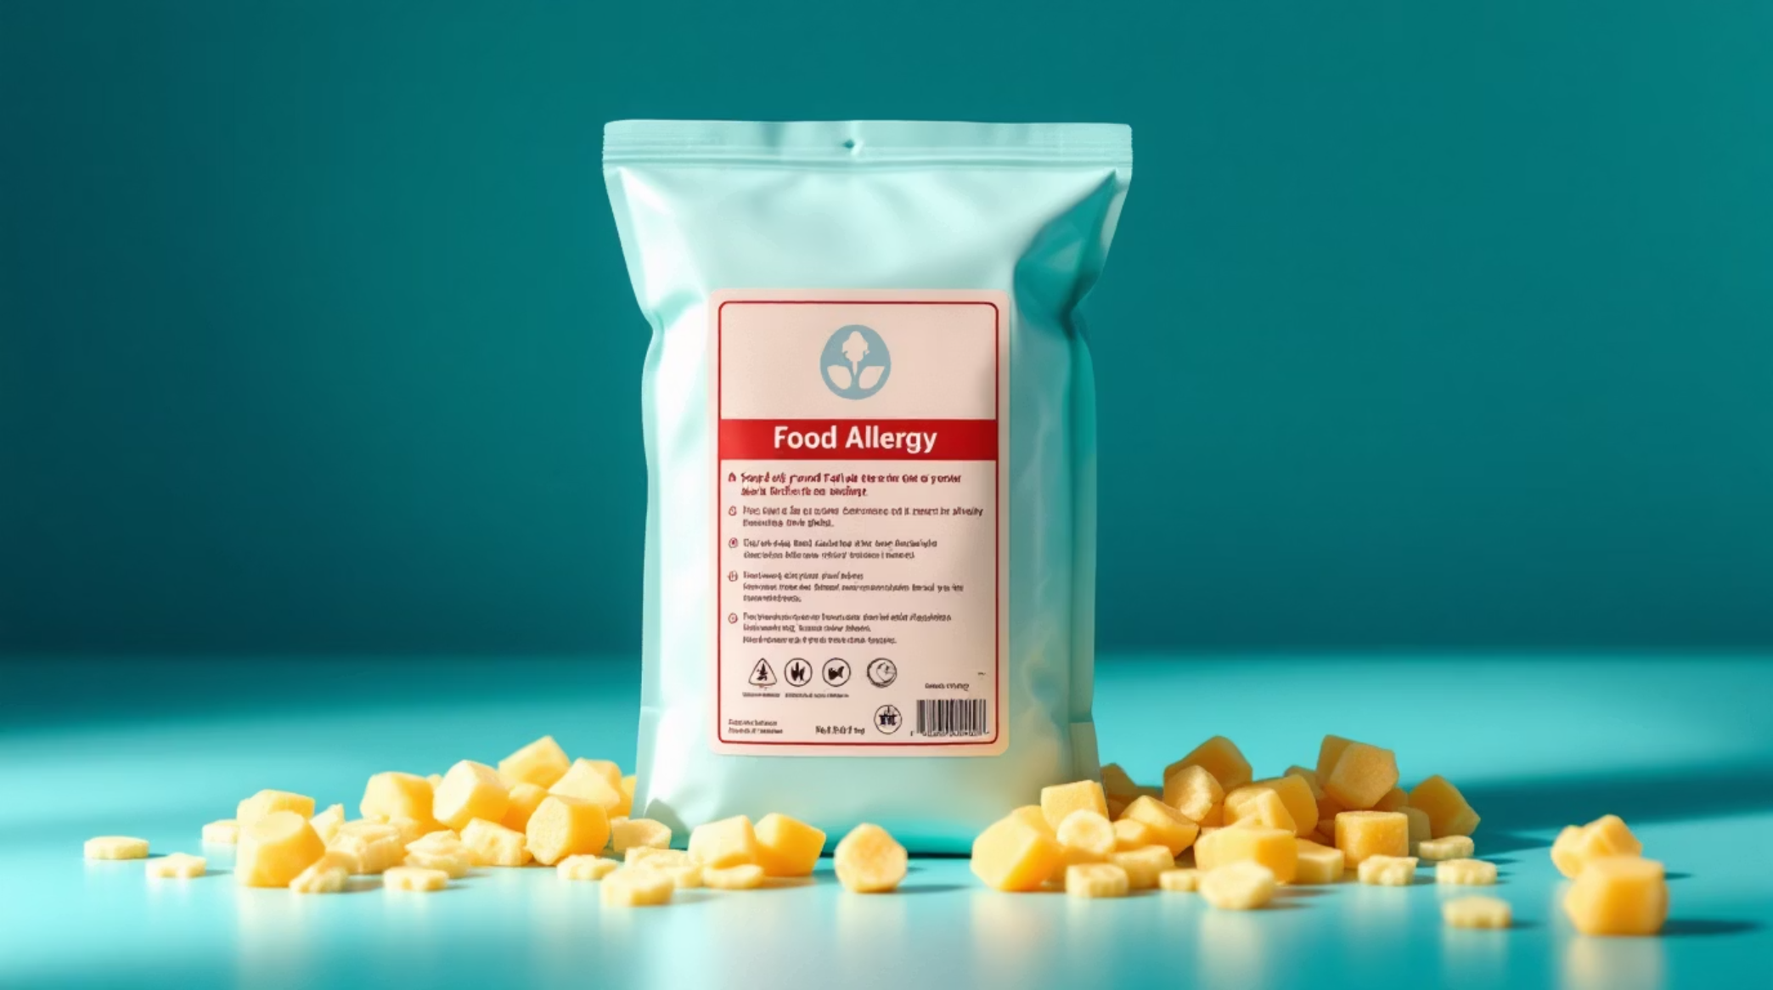
Smart Safety Signals
🔴 Red Light
High risk - Direct match detected. Contains the allergen or ingredient you've flagged
🟡 Yellow Light
Moderate risk - Traces or cross-contamination possible. Manufacturer warnings apply
🟢 Green Light
Safe to consume - No detected risk based on your profile parameters
Each signal includes detailed reasoning, detected ingredients, and supporting evidence from the ingredient analysis.

Slide 9
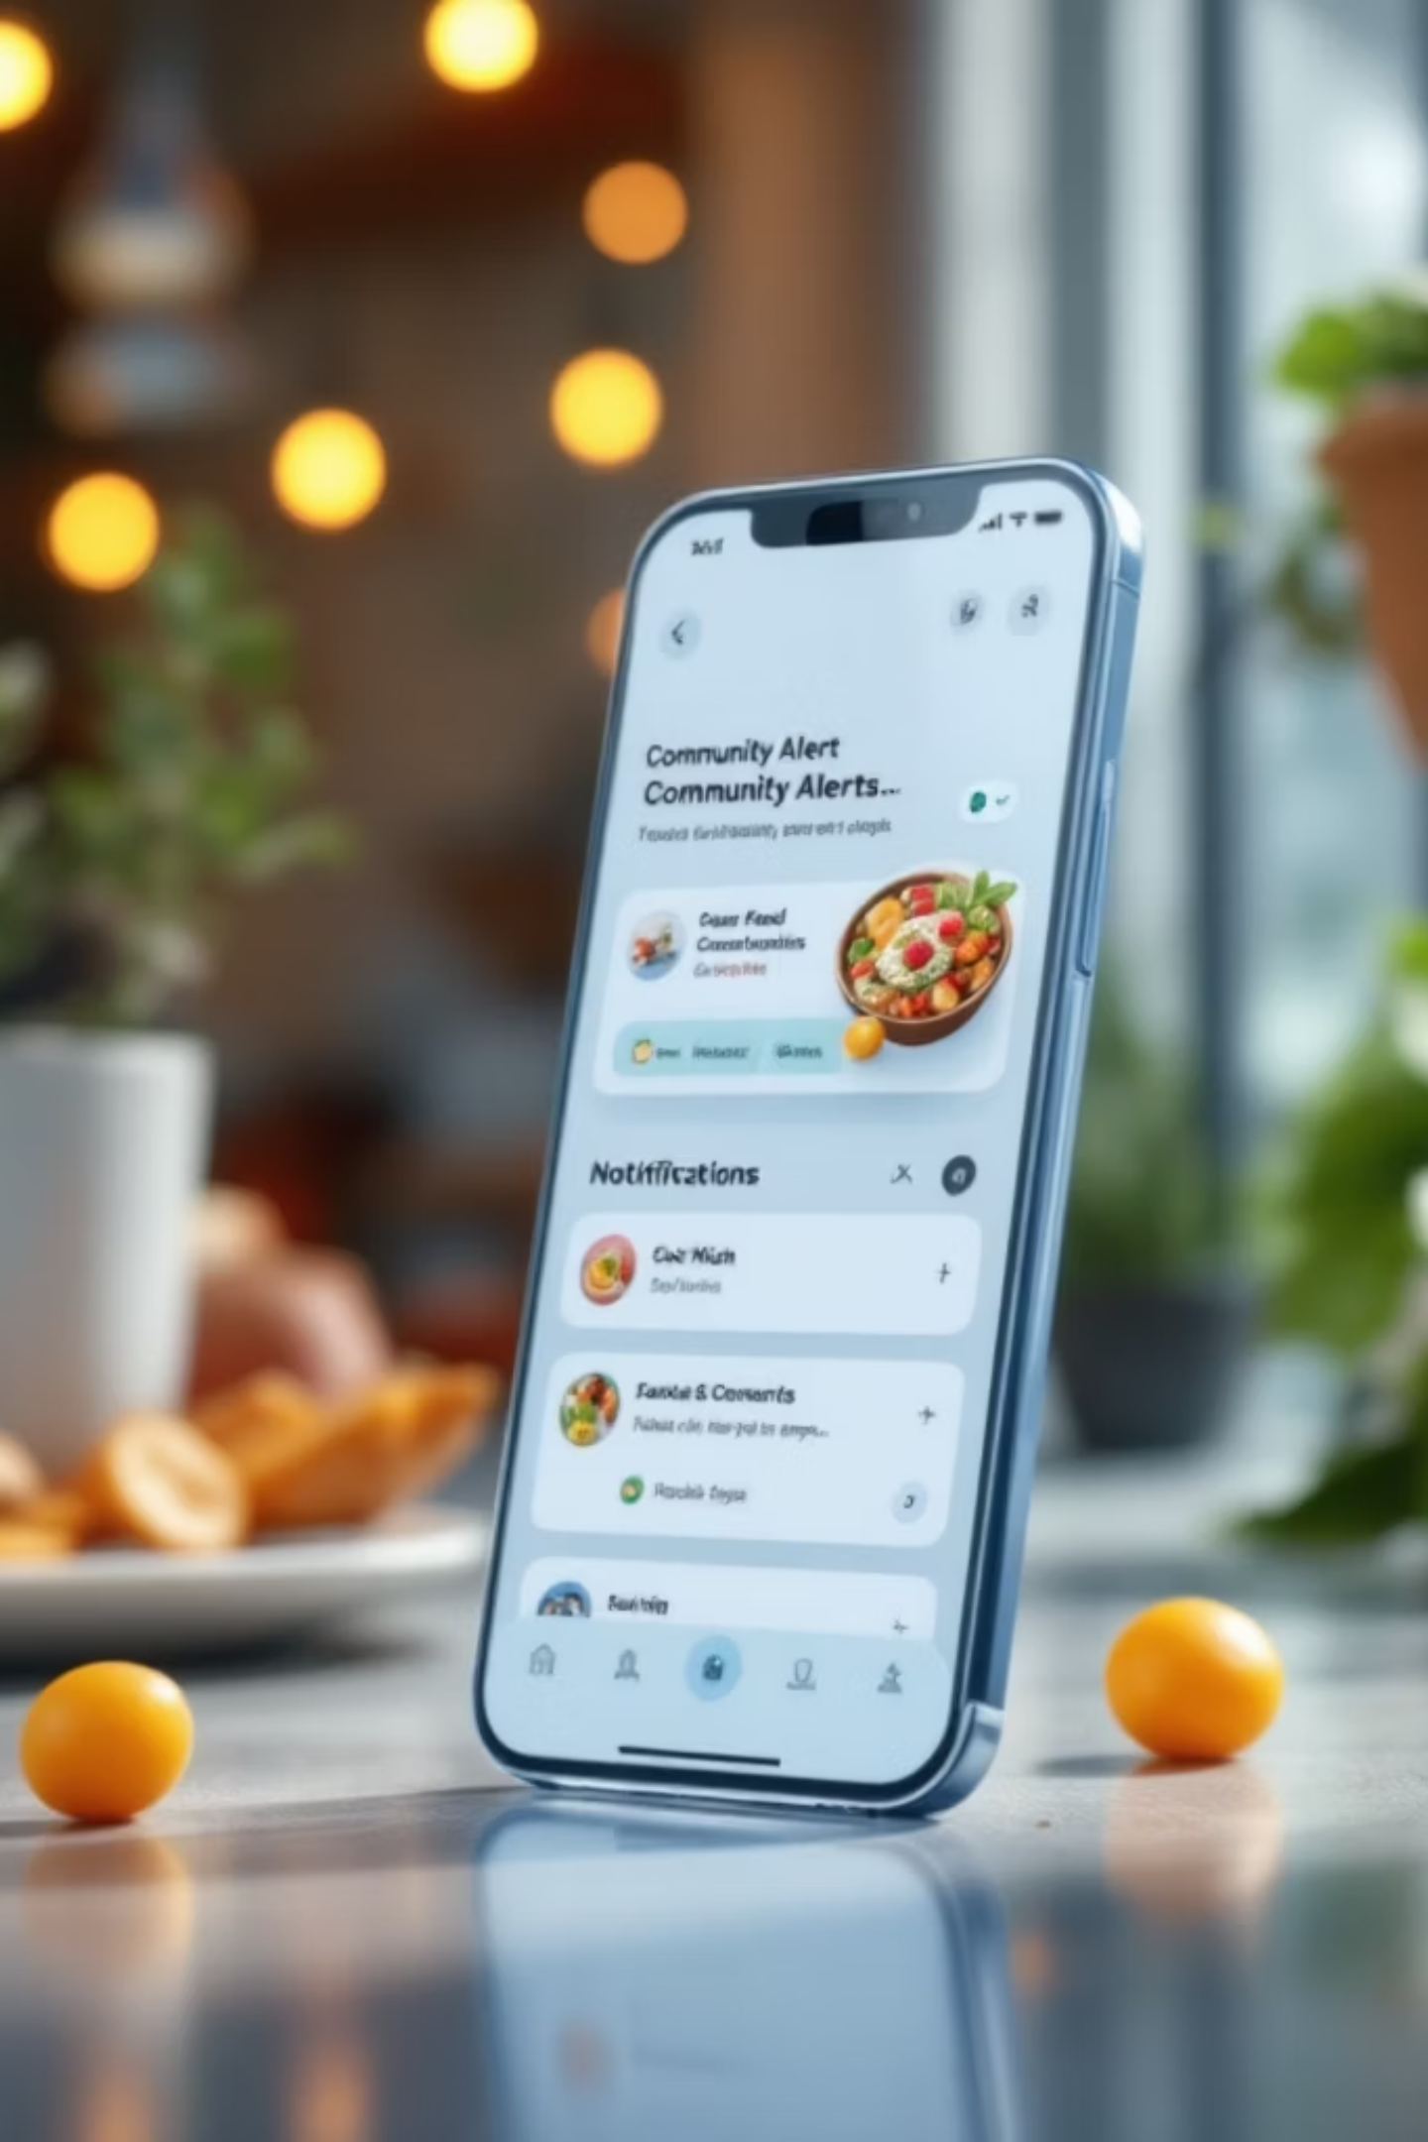
Unique SafeBite Features
Community Warning Registry
Crowdsourced feed where users report unlisted allergens, labeling errors, and real-time product issues for collective safety
Cross-API Fallback
Automatic database switching ensures coverage - if barcode isn't in Open Food Facts (Europe), system checks USDA (US) seamlessly
Secure Session Management
Cookie-based authentication with 30-day Time-To-Live ensures persistent yet secure access across sessions

